Slide 1
Certification Managemet App
Presented BY
VISHAD TRIPATHY(46022547)
intern
capgemini india pvt. ltd.

Slide 2
Abstract
The Certification Management Application is a Salesforce based application used for registering certification requests for different certifications.It comprises of two different types of users with different functionalities.The types of users in this application are App Admin and App User. App Admin is responsible for addition or removal of Certifications and its corresponding Vouchers. App User has been assigned the task of managing the Employees who are interested in different Certifications. Once the Employee is added to the system he/she can mail to the App User for processing their interest where as in response to their mail App User raises a Certification Request in the system which is then forwarded to the App Admin. App Admin decides whether to approve or reject the proposal of the employee. If the request is approved a discount voucher is assigned to the request so that employees can use it to avail discounts. User and Employees are informed automatically about every stage by the help of Email Alerts. After the due date of the Certification, App User waits for the Employee to respond about their result of the examination. This is how the app keeps a track about the whole Certification Processes.

Slide 3
Hardware specification
To be able to run the application, the minimum requirements of the hardware for this system are:
It can be used on any system with active internet connection. Salesforce platform can be used on any system with browser.
To Use the Data Loader for Windows:
• 64-bit Microsoft® Windows® 7, Windows 8, or Windows 10
• 120 MB of free disk space
• 256 MB of available memory
• Zulu OpenJDK version 11

Slide 4
Software specification
With all these, target users of this software will relatively find it not difficult to use it.
Languages : HTML, JAVASCRIPT, CSS, APEX, AURA
Browser : Google Chrome or Mozilla Firefox or Microsoft Internet Explorer
Server : It support using these systems that connect to the Internet through a proxy server.
Automatic proxy detection, Manual proxy
Data Loader

Slide 5
Existing system
In the existing system , the person has on visit the particular office for raising certification requests. The existing system’s process is quite complex and manual one.The Certification management App helps in making all the below mentioned disadvantages disappear.
Disadvantages of Existing System:-
It consumes lot of time of Employee.
Paper work results in a lot of space to keep the data.
Lack of security.
It has higher chances of human errors.

Slide 6
Proposed system
Consequently, this project work finds it necessary to study and analyze the difficulties inherent in the administration and management of certification manually in organization with a view to proposing an extensive solution to these problems.
Advantages of New System:-
It is easy to use and fast to implement.
It is application based and easy to access their information anywhere on any device.
Complete end to end solution to track certification updates
Quick and easy registration for the employers.
Online data submission is secured dual time .
Master Driven approach to reduce data entry mistake.

Slide 7
In-scope
Following is the functionality provided by the system:
There are two categories of people who would access the system: App Admin and App User. Each of these would have some exclusive privileges.
Admin:
Login into the Application
Create, edit, delete Certifications
Create, edit, delete Vouchers for registered Certifications
Approves the Certification Requests raised in the system.
View Employees
View Certification Requests

Slide 8
User:
Login into the Application
Create, edit, delete Employees
Create, edit, delete Certification Request which is submitted for approval
Assign Vouchers to the Certification Requests
Update the status of passed or failed for the approved certification requests
View Certifications
View Vouchers

Slide 9
out-scope
The following functionalities have not been covered under the application:
1.The App does not calculates the price for the application and doesn’t provides the sum total.
2.Pass/Fail is updated manually instead of being up by its own from the feedback received from the employee.
3.No login options for the employees hence they are totally rely on the email alerts to be updated about the situation. They should also be allowed to login and check their status on their own.

Slide 10
steps being followed in the App
Step 1 - Certifications are added to the system.
Step 2 - Vouchers of the existing certification are created .
Step 3 - Employees are added to the system.
Step 4 - Certification Requests are raised for the employees and sent for approval.
Step 5 - App admin will decide whether to approve or reject those requests.
Step 6 - After the request is approved vouchers are assigned to the request automatically if present.
Step 7 - Once these process are completed user waits for the Employee to send the result
Step 8 - Results will be updated by the user
These are the steps followed for a total transaction to be completed.

Slide 11
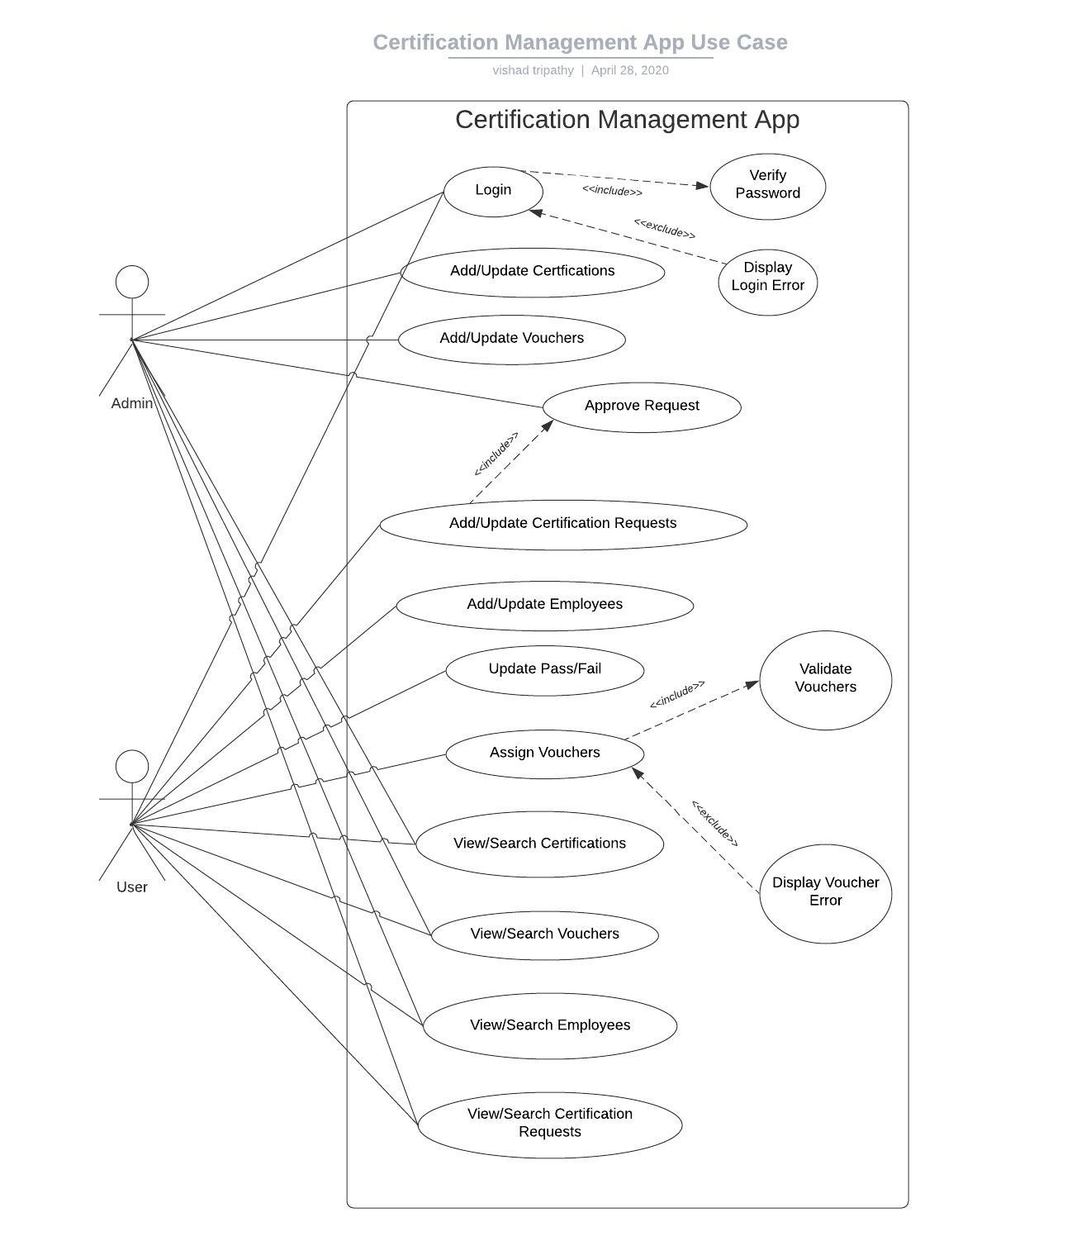
Use case diagram

Slide 12
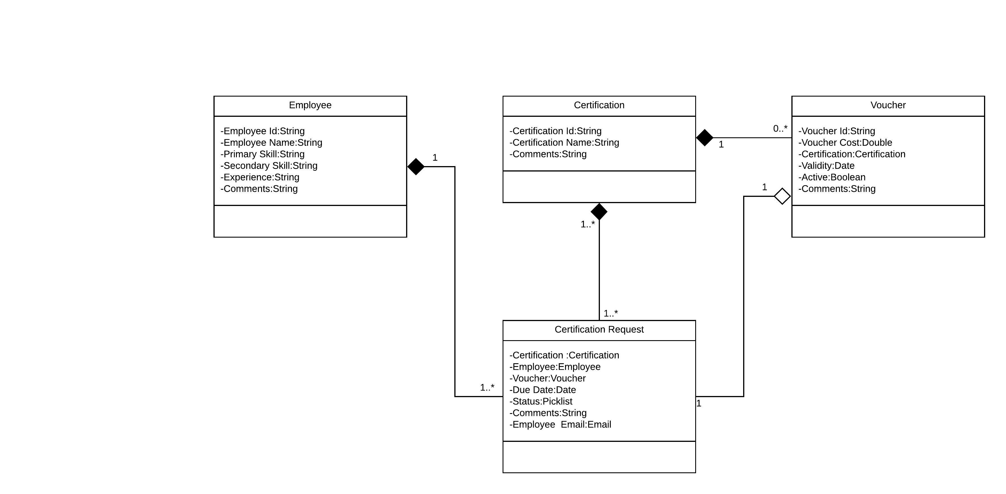
Class diagram

Slide 13
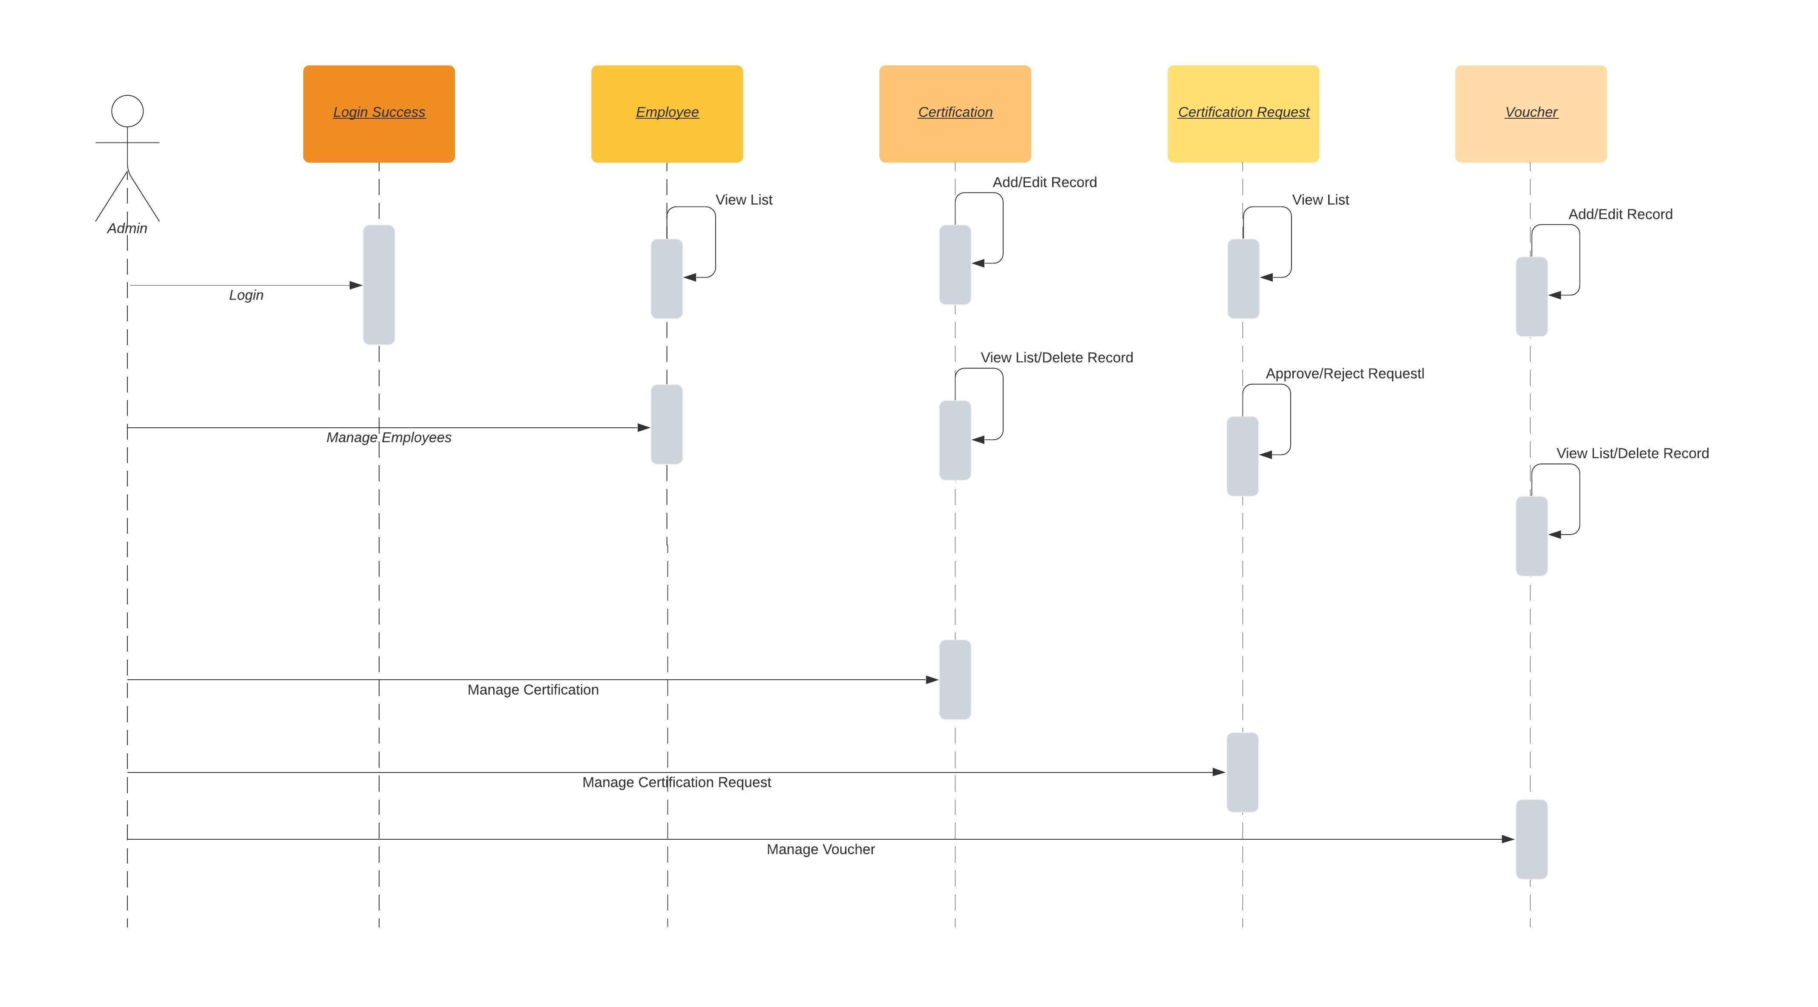
Sequence diagram For admin

Slide 14
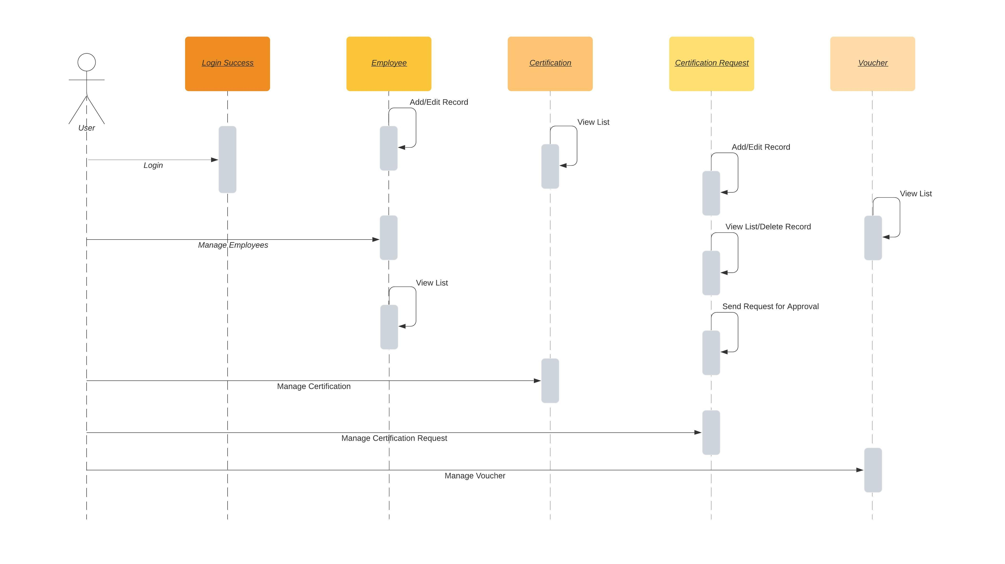
Sequence diagram For user

Slide 15
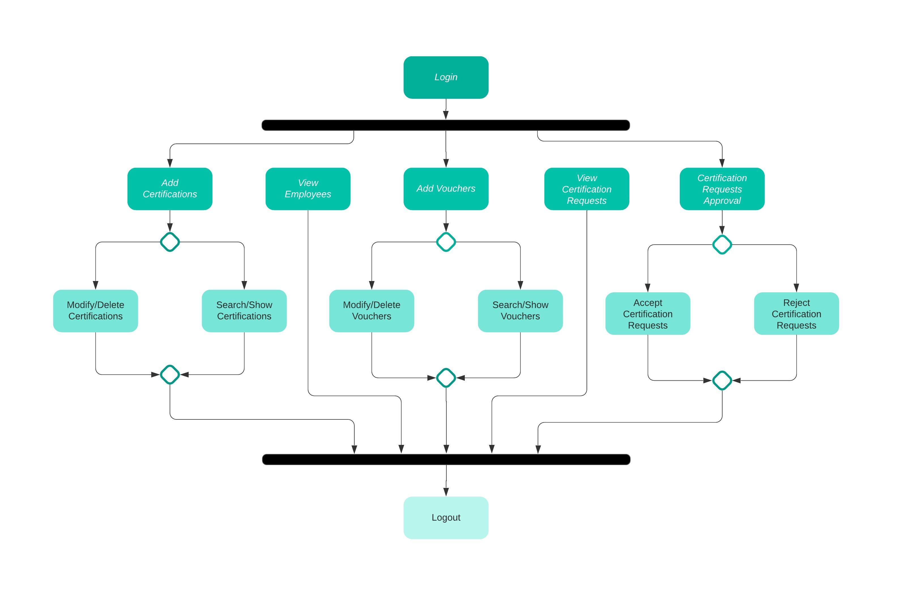
activity diagram for admin

Slide 16
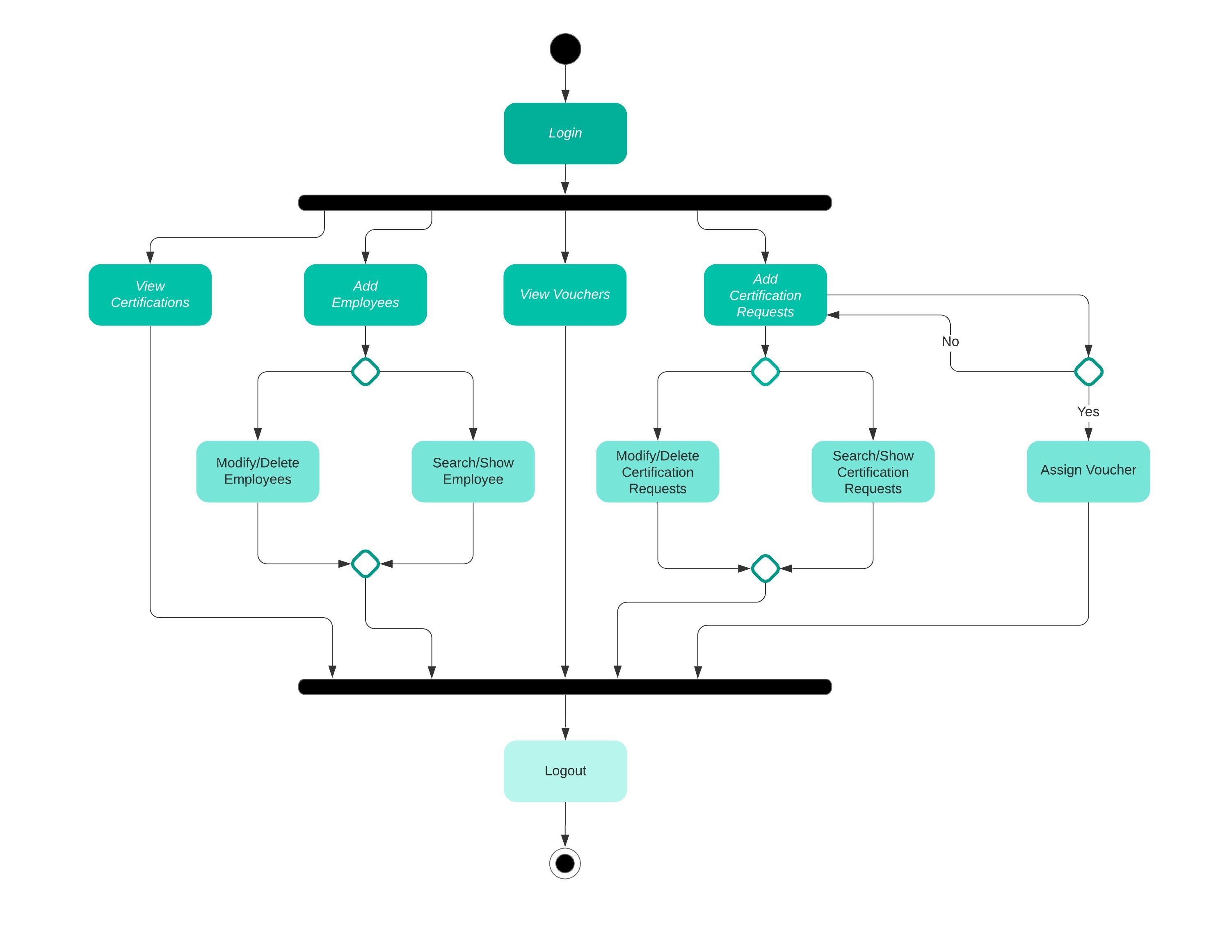
activity diagram for user

Slide 17
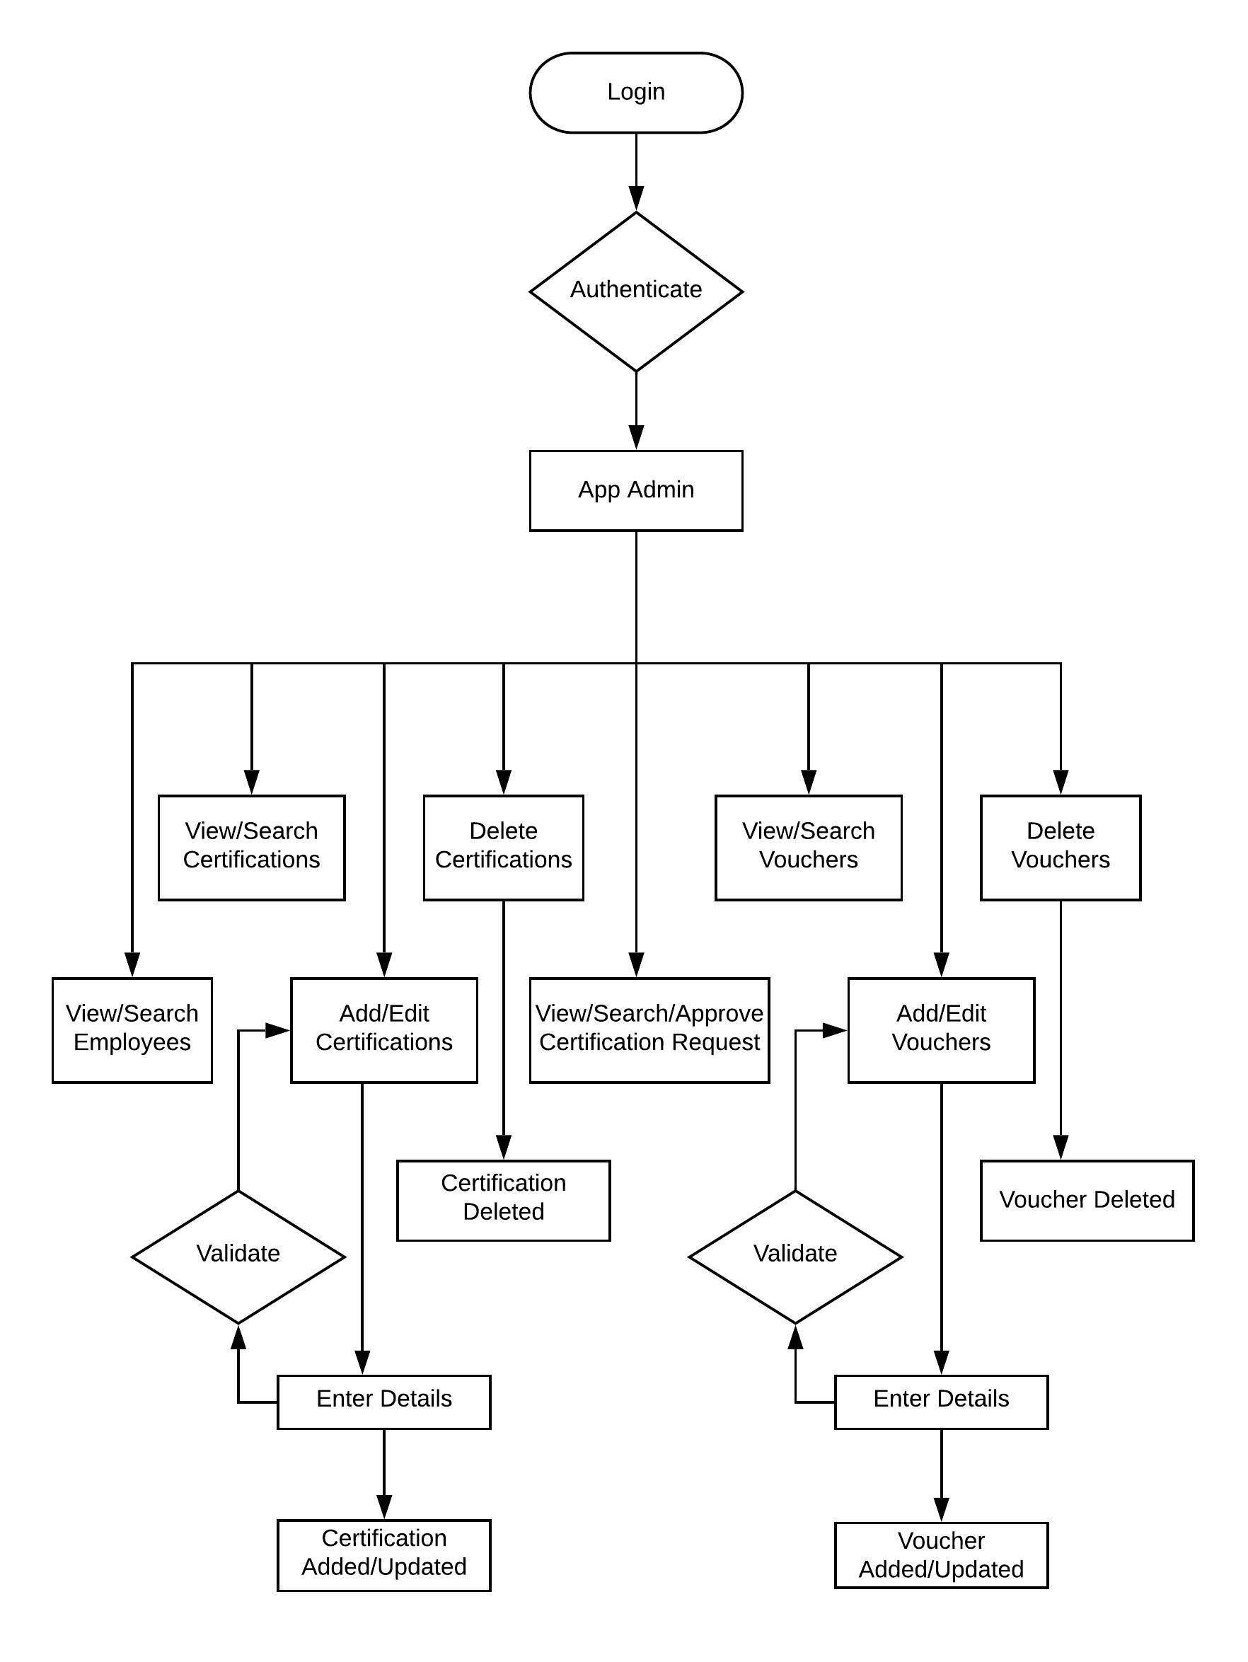
flow chart for admin

Slide 18
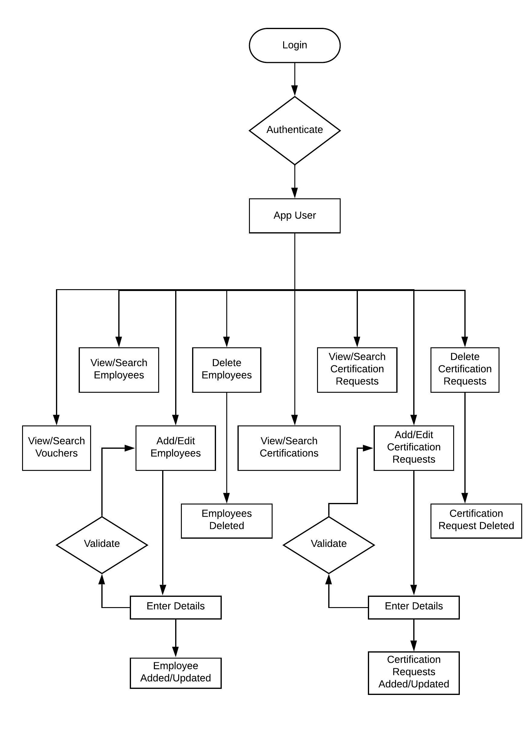
flow chart for user

Slide 19
conclusion
Certification Management Application is a user friendly record of Certification, Requests, Vouchers and Employees. It keep track of employee certification details and the results they gained. Consequently, this project work finds it necessary to study and analyze the difficulties inherent in the administration and management of cerifications manually in organization with a view to proposing an extensive solution to these problems. Certification Management is not operational excellence but instead focused on effectiveness, bring out the most of every capital investment or expense from a planning perspective.

Slide 20
THANK YOU

